Slide 1

Segmenter: Transformer for Semantic Segmentation
(Presented in ICCV 2021)
Presenter: Karthikeyan Mohanraj (AI21MTECH14007)
Faculty:
Prof. C Krishna Mohan
Dept. of CSE, IIT Hyderabad
Teaching Assistant:
Aveen Dayal
Ph.D Research Scholar
Authors:
Robin Strudel, Ricardo Garcia, Ivan Laptev, Cordelia Schmid

Slide 2
Summary of previous presentation
Motivation of the paper
What is semantic segmentation
Need for Transformer

Slide 3
Summary of previous presentation
Motivation of the paper
What is semantic segmentation
Need for Transformer

Slide 4
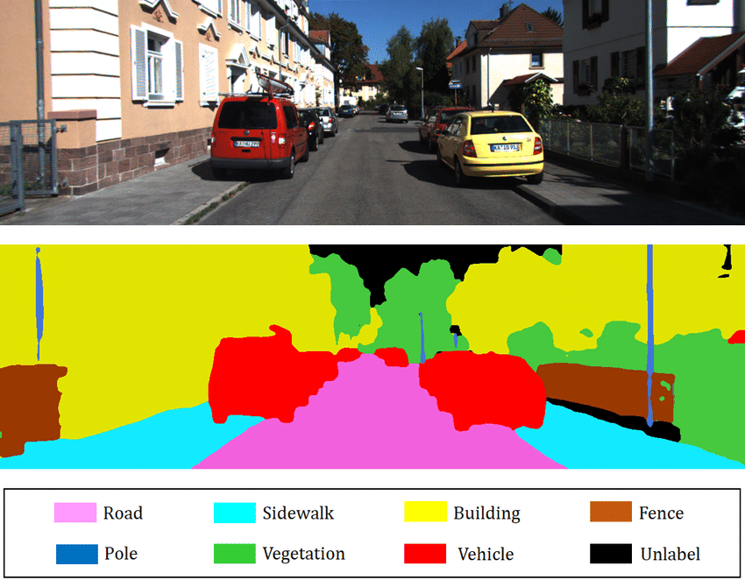
What is semantic segmentation?

Slide 5
Summary of previous presentation
Motivation of the paper
What is semantic segmentation
Need for Transformer

Slide 6
Proposed Architecture :
A fully transformer-based encoder-decoder architecture mapping a sequence of patch embeddings to pixel-level class annotations.

Slide 7
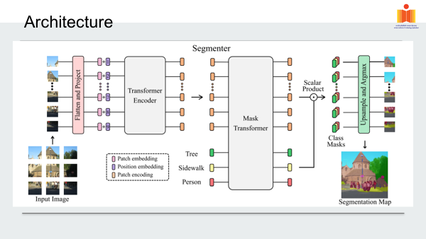

Slide 8
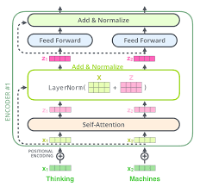
Encoder:
Components in each layer of encoder consist of :
1. Multi-headed self-attention (MSA) block.
2. Multi Layer perceptron.
3. Layer normalization and residual connection.

Slide 9
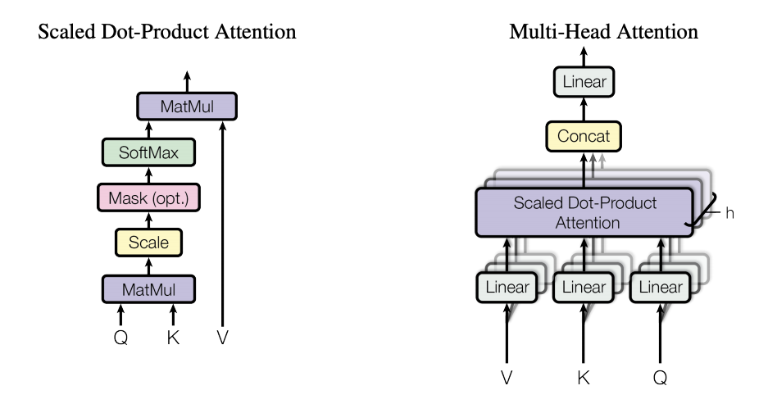

Encoder (cont…):
Multi head self attention

Slide 10
Decoder:
Mask transformer

Slide 11
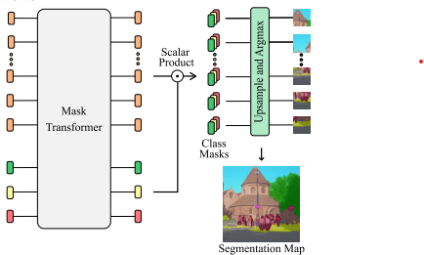

Mask Transformer:

Slide 12
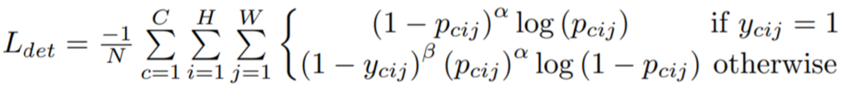
Loss function
The Loss function used is a per-pixel cross-entropy loss.

Slide 13
Dataset:
The authors used standard datasets available online such as:
ADE20K
This dataset contains challenging scenes with fine-grained labels and is one of the most challenging semantic segmentation datasets. The training set contains 20,210 images with 150 semantic classes. The validation and test set contain 2,000 and 3,352 images respectively.
Pascal Context
The training set contains 4,996 images with 59 semantic classes plus a background class. The validation set contains 5,104 images.
Cityscapes
The dataset contains 5,000 images from 50 different cities with 19 semantic classes. There are 2,975 images in the training set, 500 images in the validation set and 1,525 images in the test set.

Slide 14
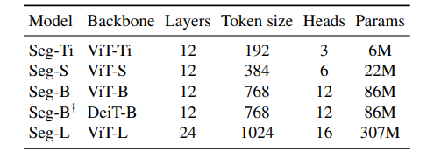
Model Implementation
Transformer encoder models.
Pretraining model with Optimization and data augmentation.
The Head size of Multiheaded self-attention block is 64.

Slide 15
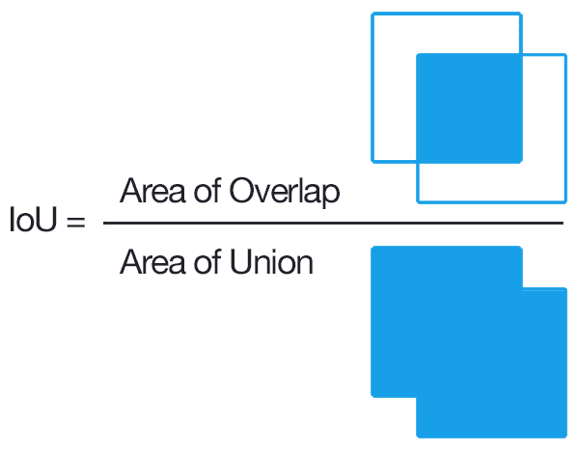
Evaluation Metric:
Mean Intersection over union(MIoU)

Slide 16
Results

Slide 17
Comparison with state of the art model:
ADE20K

Slide 18
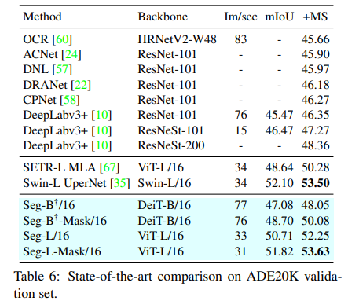
Comparison with state of the art model:
ADE20K

Slide 19
Pascal Context

Slide 20
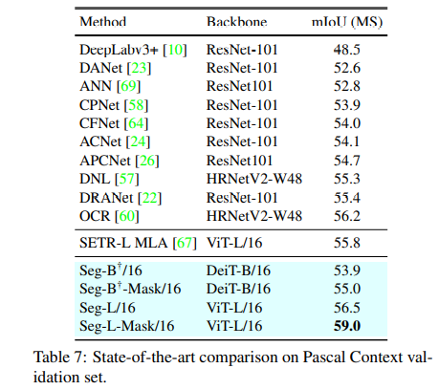
Pascal Context

Slide 21
Cityscapes:

Slide 22
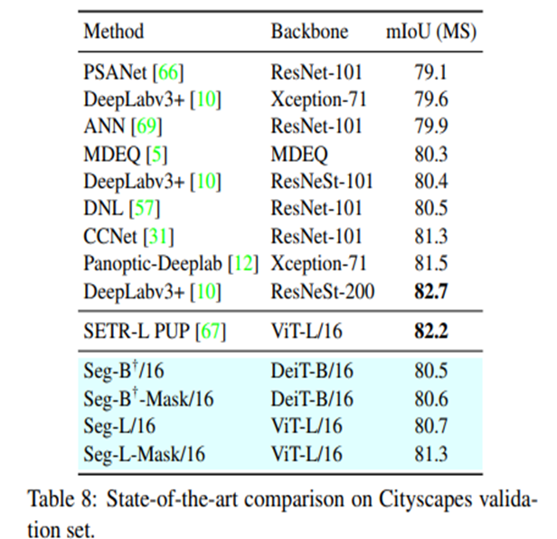
Cityscapes:

Slide 23
Results reproduced
Two variants of the Segmenter were trained with ADE20K
Seg-T-mask-16
Seg-L-mask-16

Slide 24
Epochs | Validation set MIoU - (Seg-T-Mask-16) | Validation set MIoU - (Seg-T-Mask-16)
0 | 13.18 | 29.46
5 | 25.58 | 46.39
10 | 28.58 | 48.53
15 | 30.29 | 49.34
20 | 32.08 | 49.94
25 | 33.7 | 50.53
30 | 33.98 | 50.85

Slide 25
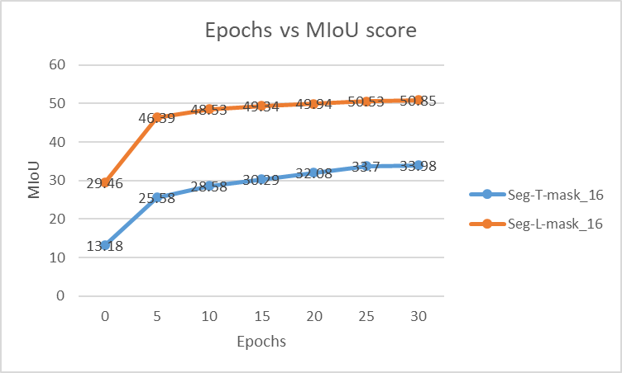

Slide 26
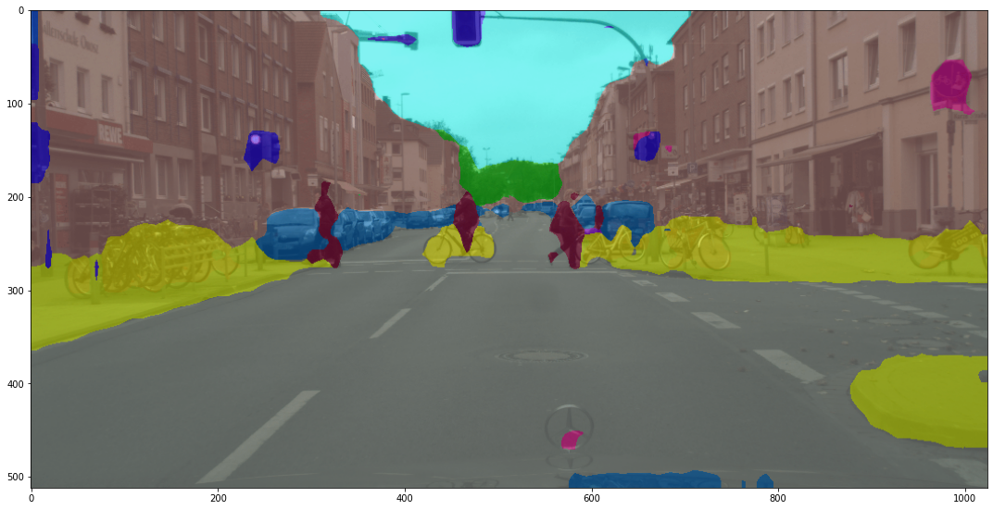
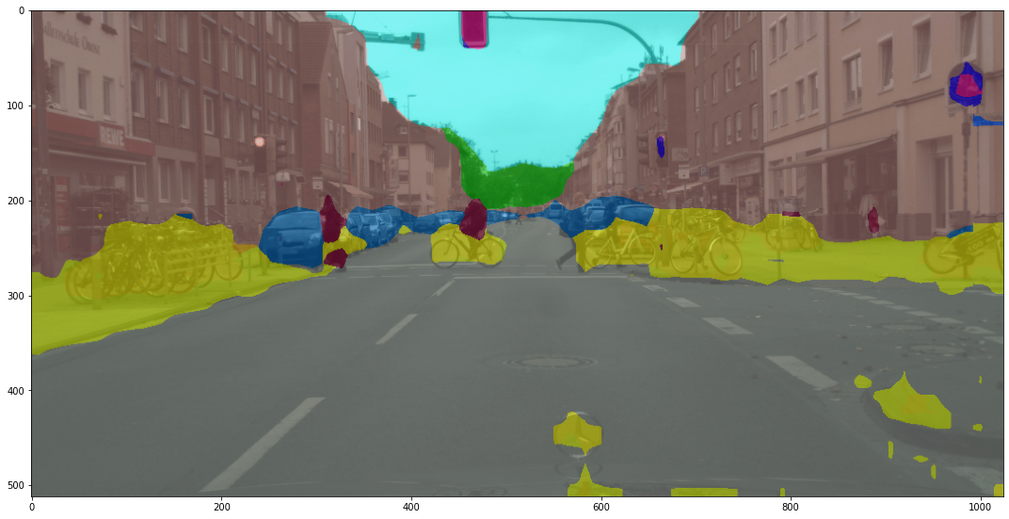
Output of Models after 30 epochs
Seg-L-Mask-16
Seg-L-Mask-16
Seg-T-Mask-16

Slide 27
Future works
ViT variants are highly computational expensive, require significant hardware, and are time-consuming.
The work can be extended to the video segmentation.
So far the model is trained and tested in images and there is lot of scope for transformer based model in video segmentation.

Slide 28
Conclusion:
This paper introduces a pure transformer approach for semantic segmentation.
Decoding with a mask transformer further improves the performance.
It outperforms state of the art models.

Slide 29
Reference:
[1]Jonathan Long, Evan Shelhamer, and Trevor Darrell. Fully Convolutional Networks for semantic segmentation. In CVPR, 2015
[2] Ashish Vaswani, Noam Shazeer, Niki Parmar, Jakob Uszkoreit, Llion Jones, Aidan N Gomez, Ł ukasz Kaiser, and Illia Polosukhin. Attention is all you need. In NeurIPS, 2017.
[3] Anurag Arnab, Mostafa Dehghani, Georg Heigold, Chen Sun, Mario Lucic, and Cordelia Schmid. ViViT: A video vision transformer. In ICCV, 2021.
[4] Lei Jimmy Ba, Jamie Ryan Kiros, and Geoffrey E. Hinton. Layer normalization. arXiv preprint, 2016. 6
[5] V. Badrinarayanan, A. Kendall, and R. Cipolla. SegNet: A deep convolutional encoder-decoder architecture for image segmentation. TPAMI, 2017. 2
[6] Huiyu Wang, Yukun Zhu, Hartwig Adam, Alan L. Yuille, and Liang-Chieh Chen. MaX-DeepLab: End-to-end panoptic segmentation with mask transformers. arXiv preprint, 2020
[7] Hugo Touvron, Matthieu Cord, Matthijs Douze, Francisco Massa, Alexandre Sablayrolles, and Herve J ´ egou. Training ´ Data-Efficient image Transformers and distillation through attention. arXiv preprint, 2020.
[8]Jonathan Long, Evan Shelhamer, and Trevor Darrell. Fully Convolutional Networks for semantic segmentation. In CVPR, 2015

Slide 30
THANK YOU

